Slide 1
Module 4: Normalization (Part-1)

Slide 2
Agenda
Informal guidelines for database design
Functional Dependencies (FDs)
Trivial and Nontrivial Dependencies
Closure of set of Functional Dependencies
Different Normal Forms (1NF to 3 NF)
Examples on Normalization

Slide 3
Informal Guidelines
Design a relation schema so that it is easy to explain its meaning
Design the base tables so that no Insertion, Deletion, or Update anomalies are present in the relations
Avoid populating tuples that may probably have null values

Slide 4
Redundancy
BrId | BrName | BrCity | Assets | LoanNo | CName | Amount
752 | VV Puram | Bangalore | 1000000 | 3859 | Pooja | 50000
862 | MG Road | Bangalore | 2000000 | 1107 | Gopal | 12000
862 | MG Road | Bangalore | 2000000 | 2010 | Suresh | 25000
862 | MG Road | Bangalore | 2000000 | 4926 | Chitra | 20000
912 | VTU | Belgaum | 5000000 | 4999 | Kim | 30000
912 | VTU | Belgaum | 5000000 | 5100 | Gopal | 10000

Slide 5
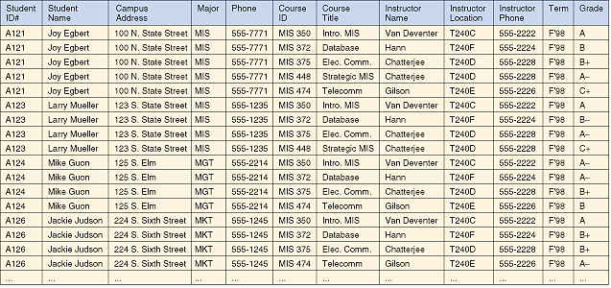
Example - 2

Slide 6
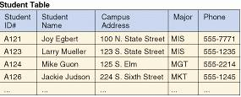




Normalized Tables

Slide 7
Anomalies
Insertion anomaly
we can't insert a record with out having at least one customer! This is a perfect example for insertion anomaly.
950 Koramangala Bangalore 1000000 ? ? ?
Update anomaly
Assume that the branch with BrId = 862 is shifted to Residency Road from MG Road. All the relevant tuples must be updated to reflect this new branch name.

Slide 8
Anomalies…
Deletion Anomaly
If the customer Pooja (LoanNo = 3859) closes her account, then entire branch information is lost
Null values
Can we use Null values in tables?

Slide 9
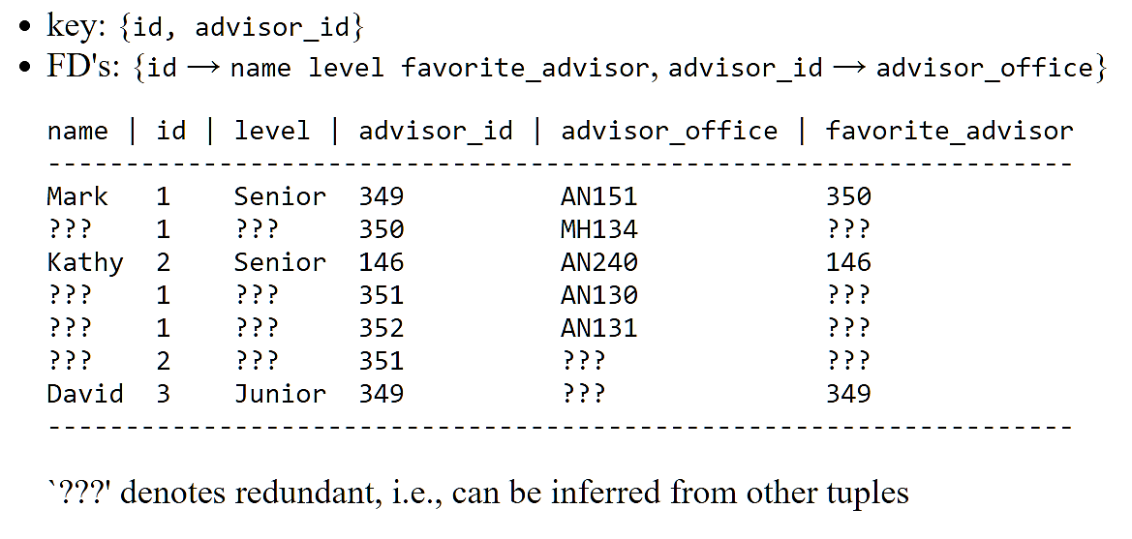
Example-2
Student
update anomaly (more serious of the two): what happens if we update the favorite_advisor of Mark?
deletion anomaly: if 350 is not the advisor for anybody, we lose their room info!

Slide 10
Functional Dependencies (FD)
A functional dependency (FD) is a constraint between two sets of attributes.
A functional dependency denoted by X → Y (read as "Y is functionally dependent on X").
The left-hand side of the FD is some times called as the determinant and the right-hand side is called dependent.
Example
(1) SSN → Name
(2) PNumber → {PName, PLocation}
(3) {SSN, PNumber} → Hours

Slide 11
Example - 2
SupplierId | City | ProdId
S10 | Bangalore | P1
S10 | Bangalore | P2
S20 | Chennai | P1
S30 | Bangalore | P1
S30 | Bangalore | P4
S40 | Belgaum | P2
SupplierId → City
{SupplierId, ProdId} → City

Slide 12
FD Diagrams
SSN | Name | BDate | Addr | DNumber | DName | DMGRSSN
FD1 FD2
FD1: SSN → {Name, BDate, Addr, DNumber}
FD2: DNumber → {DName, DMgrSSN}

Slide 13
Classification of FDs
Trivial / Non-Trivial FDs
An FD X → Y
where, Y ⊆ X - called a trivial FD, it always holds good (Y is a subset of X)
An FD X → Y
where, Y ⊈ X - non-trivial
FD An FD X → Y
where, X ∩ Y = ϕ - completely non-trivial FD (i.e. no overlap between X and Y)

Slide 14
Example
Trivial
AB → A, AB → B, A → A, AB → AB
{USN, Name} → USN
Non-Trivial
AB → C, {USN, Name} → Grade
AB → BC because B is common
Complete Non-Trivial
AB → CD

Slide 15
Closure of a set of FDs
Given some FDs, new FDs can often be inferred.
The set of all FDs that are implied by a given set F of FDs is called the closure of F and is denoted by F⁺.
Example:
Let F = {AB → C, C → B} be a set of FDs satisfied by R (A, B, C). Then,
F⁺ = {A → A, AB → A, B → B, AB → AC, AB → BC, AB → ABC, etc.}

Slide 16
Armstrong's Axioms
IR-1: Reflexivity: If X ⊇ Y, then X → Y.
(if X is a superset of Y or Y is a subset of X)
IR-2: Augmentation: If X → Y, then XZ → YZ.
IR-3: Transitivity: If X → Y and Y → Z, then X → Z.
IR-4: Decomposition: If X → YZ, then X → Y and X → Z.
IR-5: Union: If X → Y and X → Z, then X → YZ.

Slide 17
Example
Supposing we are given a relation R{A, B, C, D, E, F} with a set of FDs as shown below:
A → BC
B → E
CD → EF
Let us show that the FD AD → F holds for R and is a member of the closure.
(1) A → BC {Given}
(2) A → C {Decomposition of (1)}
(3) AD → CD {Augmentation of (2) by adding D}
(4) CD → EF {Given}
(5) AD → EF {Transitivity of (3) and (4)}
(6) AD → F {Decomposition of (5)}

Slide 18
Attribute closure, X⁺
To compute F⁺, start with FDs in F; repeatedly apply IR-1 to IR-3 until no new FD can be derived
Armstrong's Axioms do not produce any incorrect FDs that are added to F⁺. However, finding F⁺ is too expensive; the complexity grows exponentially
The solution is to find the attribute closure of X, denoted as X⁺

Slide 19
Algorithm to find X⁺
Algorithm Attribute_Closure()
{
X⁺ = X;
Repeat {
For each FD U → V in F do
if U ⊆ X⁺ then X⁺ ∪ V
// i. e. if U is in X⁺, the add V to X⁺
until no change;
// until no more attributes are added to X⁺
}
}

Slide 20
Example
Consider R (A, B, C) and a set of FDs
F = {AB → C, C → B}
Using the Algorithm, we calculate the following closure sets with respect to F:
A⁺ = {A},
B⁺ = {B},
C⁺ = {C, B} because of FD-2
{AB}⁺ = {ABC} because of FD-1 add C
{AC}⁺ = {ACB} because of AC → AB add B
{BC}⁺ = {BC} nothing can be added
{ABC}⁺ = {ABC} nothing can be added

Slide 21
Candidate Keys
Finding candidate keys
Step-1: Draw the dependency graph of F. Each vertex corresponds to
an attribute.
Edges can be defined as follows:
A → B becomes A B
A → BC becomes A B
C
AB → C becomes A B
C
Step-2: Identify the set of vertices Vni that have no incoming edges.
Step-3: Identify the set of vertices Voi that have only incoming edges.
Step-4: A candidate key is a set of attributes that
(a) contains all attributes in Vni.
(b) contains no attributes in Voi.
(c) has no subset that is already a candidate key.

Slide 22
Example - 1
Consider R (A, B, C, G, H, I), and
F = {A → BC, CG → HI, B → H}.
B
H
A
C
I
G
Vni = {A, G} – ‘no incoming’
Voi = {H, I} – ‘only incoming’
(AG)⁺ = {A, B, C, G, H, I},
AG is the only candidate key

Slide 23
Example - 2
Consider R(A, B, C, D, E, H), and
F = {A → B, AB → E, BH → C, C → D, D → A}
A
B
C
D
E
H
Vni = {H} and Voi = {E}
Candidate keys = AH, BH, CH, and DH

Slide 24
Algorithm
Algorithm CandidateKey(R, F)
1. LS ← φ; RS ← φ; BS ← φ; CK ← φ
2. Build the dependency graph for R and F.
3. From the graph compute the following:
LS ← LS ∪ all vertices with zero indegree
RS ← RS ∪ all vertices with zero outdegree
BS ← BS ∪ all vertices with nonzero in and out degree
4. If LS = φ and RS = φ Then
use the algorithm of [3] // all attributes in BS
5. If LS⁺ = R then
CK ← CK ∪ LS;
goto step 7.
6. For each attribute A ∈ BS do
LS ← LS ∪ A;
If LS⁺ = R Then CK ← CK ∪ LS;
LS ← LS – A;
7. Return CK.

Slide 25
Algorithm CK with sets
Algorithm CandidateKey_Set(R, F)
1. LS ← φ; RS ← φ; BS ← φ; CK ← φ
2. For each FD do:
LS ← LS ∪ all attributes appearing only in LHS
RS ← RS ∪ all attributes appearing only in RHS
BS ← BS ∪ all attributes appearing on both the sides
3. If LS = φ and RS = φ Then
use the algorithm of [3] – exhaustive method
4. If LS⁺ = R then
CK ← CK ∪ LS;
Return CK.
5. For each attribute A ∈ BS do
LS ← LS ∪ A;
If LS⁺ = R Then CK ← CK ∪ LS;
LS ← LS – A;
6. Return CK.

Slide 26
Example - 3
R (A, B, C, D, E, F) and
F = {A → B, B → A, B → C, C → D, D → C, BD → E, E → F, F → E}
It is not easy to compute CK!!!
A
B
E
F
C
D

Slide 27
FIRST NORMAL FORM (1NF)
Definition: A relation schema R is in first normal form (1NF) if every attribute of R takes only single and atomic values.
Example:
Employee
SSN | Name | Age | DepName
1234 | Kiran | 40 | {Madan, Pradeep}
7089 | Prasad | 44 | {Seema}
1357 | Kathy | 38 | {John, Andy}

Slide 28
1NF…
Violates 1NF, because of DepName.
Solution 1:
Use multiple tuples – one per value.
Employees(SSN, DepName, Name, Age)
For example, the first row can be split into
{1234, Madan, Kiran, 40} and {1234, Pradeep, Kiran, 40}
Solution 2:
Split the Employee table into two different tables.
Employees(SSN, Name, Age)
Dependents(SSN, DepName)

Slide 29
SECOND NORMAL FORM (2NF)
Definition: A relation schema R is in 2NF if and only if it is in 1NF and every non-prime attribute in R is fully functionally dependent on primary key (or every candidate key)
Full Functional Dependency
The FD X → Y in R is a full FD, if removal of any attribute A from X makes the dependency does not hold any more on R.
Example: {SSN, PNo} → Hours
Partial Functional Dependency
When an attribute is removed from a relation and if the dependency still holds good, then such a FD is said to be partial.
Example: {SSN, PNo} → Name

Slide 30
Alternate Definitions
A relation schema R is in 2NF if and only if it is in 1NF and every non-prime attribute in R is irreducibly dependent on the primary key.
In a FD X → A, if X is a proper subset of some key K, then such a dependency is called as partial dependency (X ⊂ K).
Example:
Reserves(Sailor#, Boat#, Date, Credit#)
The only key is SBD and FD S → C
Key
A
X

Slide 31
Example
SuppProd (Not in 2NF)
S# | STATUS | CITY | P# | QTY
S1 | 20 | LONDON | P1 | 300
S1 | 20 | LONDON | P2 | 200
S2 | 10 | PARIS | P1 | 100
S3 | 20 | LONDON | P1 | 400
S3 | 20 | LONDON | P2 | 100
S3 | 20 | LONDON | P3 | 300
Solution:
Supplier(S#, STATUS, CITY)
Product(S#, P#, QTY)

Slide 32
THIRD NORMAL FORM (3NF)
Definition: A relation schema R is in 3 NF, if it is in 2 NF and no nonprime attribute of R is transitively dependent on the primary key.
Transitive Dependency: A FD X → Y in a relation schema R is a transitive dependency if there is a set of attributes Z that is not a subset of any key of R, and both X → Z and Z → Y hold.
Example:
EmpDept (SSN, Name, BDate, Addr, DNo, DName, MgrSSN)
FD-1: SSN → {Name, BDate, Addr, DNo}
FD-2: DNo → {DName, MgrSSN}

Slide 33
Transitive Dependencies
SSN | Name | BDate | Addr | DNo | DName | MGRSSN
Case 1:
Case 2:
Key
A
X
Key
X
A

Slide 34
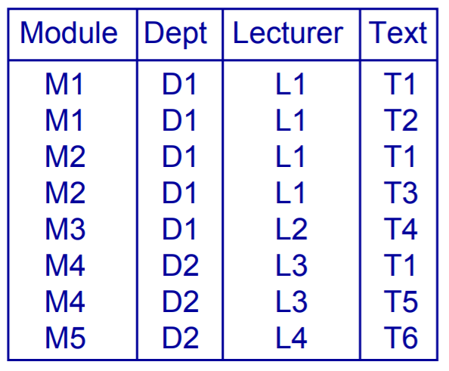
Another Example
MDLT (not in 2NF)
{Module, Text} → {Lecturer, Dept}
{Module} → {Lecturer, Dept}
(Lecturer} → {Dept}
Partial Dependency
Key
{Module, Text}

Slide 35
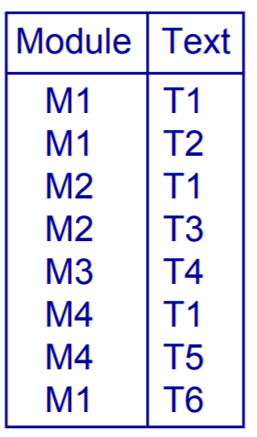
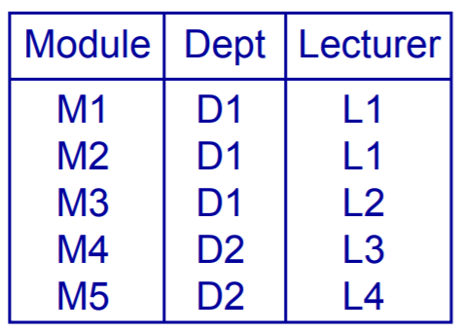
Make it 2NF
MT MDL

Slide 36
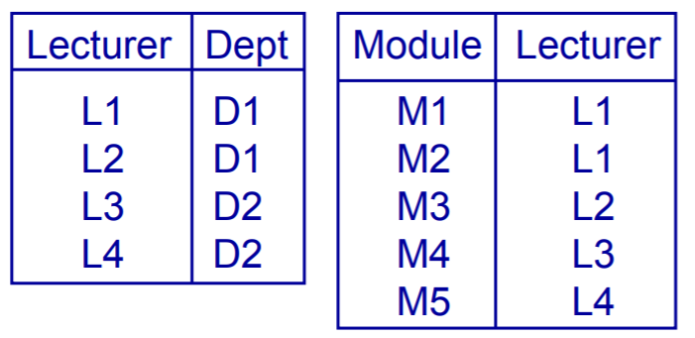
Make it 3NF
MDL LD ML
Module → Lecturer
Lecturer → Dept
Transitive dependency
3NF Relations

Slide 37
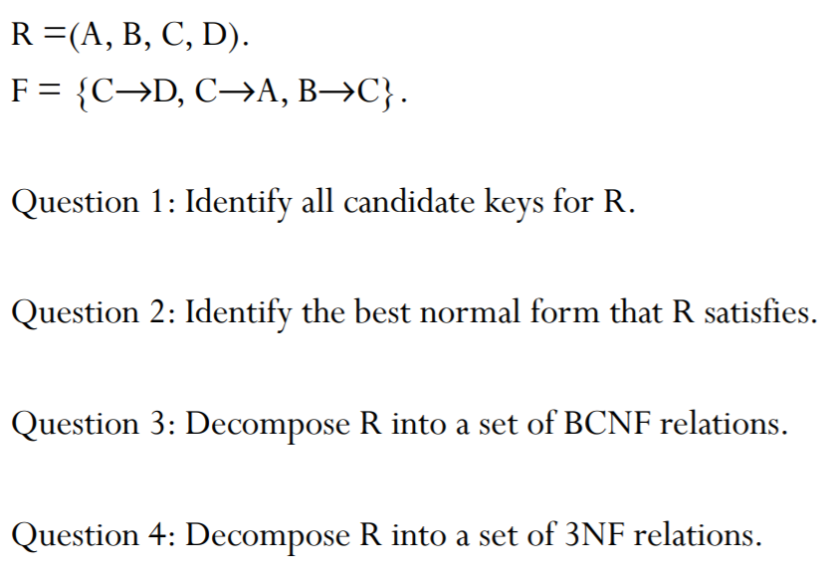
Exercise

Slide 38
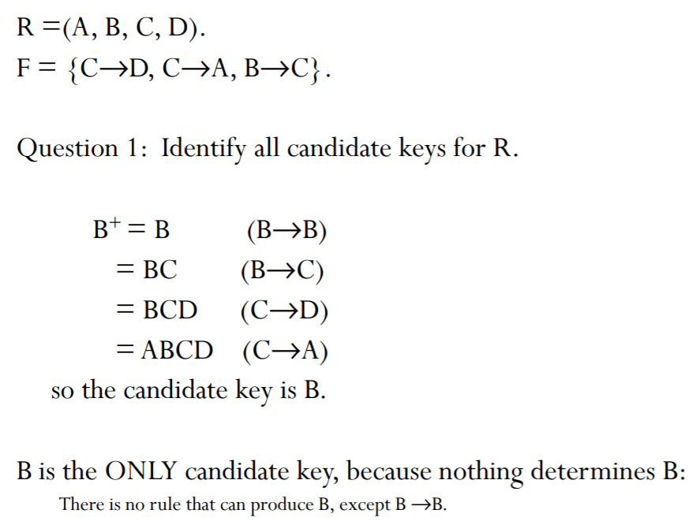
Solution

Slide 39
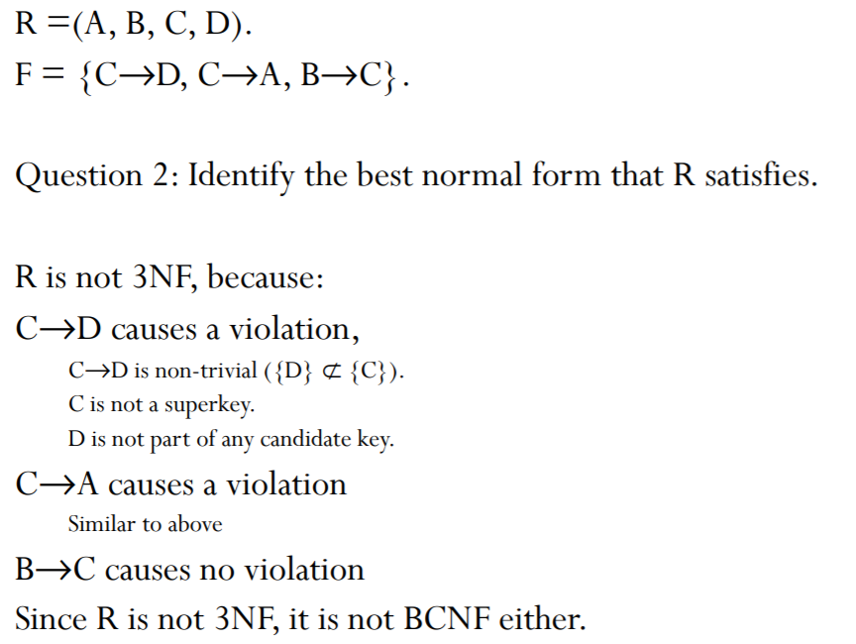
Solution…

Slide 40
More Examples
TE | ST | DES | MS
Dr. Rao | Sameer | P | 30000
Murthy | Albert | AP | 20000
Saksena | Poorvik | L | 15000
Dr. Rao | Poorvik | P | 30000
Saksena | Kiran | L | 15000
(1) TS → D
(2) TS → M
(3) D → M
1NF: TStd is in 1NF.
2NF: Not in 2NF (why?)
TS1(T, S) and TS2(T, D, M)
3NF: TS1 is in 3NF & BCNF.
TS2 is not in 3NF (why?)
TS21(T, D) and TS22(D, M)

Slide 41
Covers
Covers: reduced set of FDs that are representative of F⁺ (since F⁺ is too large)
Assuming another set of FDs G, we say that F and G are equivalent, if F⁺ is equivalent to G⁺.
Alternatively, G covers F, if every FD in G is also in F⁺ . When F⁺ = G⁺, we can state that F covers G and G covers F.
Example:
Suppose F1 = {A → B, A → C} and F2 = {A → B, B → C} and as per the definition every FD in F1 is also in (F2)⁺. Note that, (F2)⁺ = (A → B, B → C, A → C}. Therefore, we conclude that F1 covers F2.
F3 = {A → C, C → B, B → C} and F4 = {A → B, B → C, C → B}

Slide 42
Minimal Cover
A set of FDs F is minimal and can be represented as a set of FDs G if it satisfies the following conditions:
Every FD in G has a single attribute on its right-hand side, i.e. X → A, where A is a single attribute.
No FD can be removed from G and still have a set of FDs that is equivalent to F.
We can not replace any FD: X → A in F with a dependency Y → A, where Y ⊂ A and still have a set of dependencies that is equivalent to F.

Slide 43
Examples
{A → B, A → C} is minimal.
{B → AC} is not minimal, violating condition (a).
{AB → C, D → F} is minimal.
{AB → C, A → B} is not minimal, violating condition (c).
{A → B, B → C, A → C} is not minimal, violating condition (b).
Let us illustrate with some examples as given below:
{A → B, B → C} is a minimal cover of {A → B, B → C, A → C}.
{A → C, A → B} is a minimal cover of {AB → C, A → B}.

Slide 44
Algorithm to find the Minimal cover
Step-1: | G = F.
Step-2: | Transform G into a set of FD's with right hand side containing only one attribute.
Step-3: | Eliminate a redundant attribute from left-side. For each dependency A₁, A₂, ..., A_{k} → B in current set of G, and each attribute Ai in its left-side, if [G - {A₁, A₂, ..., A_{k} → B }] → {A₁, A₂, ..., A_{i -1}, A_{i+1},..., A_{k} → B} is equivalent to G. then delete Ai from the left side of A₁, A₂, ..., A_{k}→B.
Step-4: | Eliminate a redundant dependency For each dependency X → Y in the current set of dependencies G if G - {X → Y} is equivalent to G then delete X → Y from G.

Slide 45
Eliminating Attribute(s) from LHS
In an FD {X → A} from set F, attribute B ∈ X is extraneous in X if F logically implies
(F – {X → A}) ∪ {(X – B) → A}.
To test if attribute B ∈ X is extraneous in X
Step 1: compute ({X} – B)⁺ using the dependencies in F
Step 2: check that ({X} – B)⁺ contains B; if it does, B is extraneous

Slide 46
Example 1
R(A,B,C); F = {AB → C, A → B}.
AB → C has two attributes in LHS
(AB-A)⁺ = B
B⁺ = {B} So A is not extraneous
(AB-B)⁺ = A
A⁺ = {AB} Since it includes B, it is extraneous
Minimal Cover = {A → C, A → B}.

Slide 47
Example 2
F = { AB -> C, C -> A, BC -> D, ACD -> B, D -> E, D -> G, BE -> C, CG -> B, CG -> D, CE -> A, CE -> G}
Consider ACD -> B to see if any of the three attributes on the LHS is extraneous. Start with A.
We need to compute ({ACD} – A)⁺ using the dependencies in F and check if the result contains A; if it does, attribute A is extraneous.
Computing CD⁺, we get ACDEGB which contains A and therefore, A is extraneous.
Also the closure contains B, which tells us that CD -> B holds.

Slide 48
Example 3
Find the Minimal Cover of
F = { AB -> C, C -> A, BC -> D, ACD -> B, D -> E, D -> G, BE -> C, CG -> B, CG -> D, CE -> A, CE -> G}
Step 1: All FDs have single attributes on RHS.
Step 2:
AB->C : Remove B, A⁺ = {A} can’t remove B
AB->C : Remove A, B⁺ = {B} can’t remove A
BC -> D : No,
ACD -> B : A can be removed (previous slide)
No more FDs in which LHS attribute could be removed

Slide 49
Example 3….
Redundant FDs removal
G = { AB -> C, C -> A, BC -> D, CD -> B, D -> E, D -> G, BE -> C, CG -> B, CG -> D, CE -> A, CE -> G}
Is CE -> A redundant? YES C -> A, CE-> AE
Is CG -> B redundant? YES How?
CG -> D, C -> A, and CD -> B
CD->B,
CG->D, Augment C
CCG->CD, CG->CD,
CG->CD and CD->B and so CG->B (Transitivity)
Minimal Cover 1: {AB -> C, C -> A, BC -> D, CD -> B, D -> E, D -> G, BE -> C, CG -> D, CE -> G}

Slide 50
Example 4
Given F = {AB → C, A → D, BD → C, D → BG, AE → F}
Make all FDs with single attributes in the right-side (only FD-4 need to be split).
Step-1: G = F
Step 2: G = {AB → C, A → D, BD → C, D → B, D → G, AE → F}
Step 3: The only FDs to be considered are
AB → C, BD → C, AE → F.
For AB → C, we want to find whether A → C or B → C holds or not.
Because A → D, D → B implies A → B (transitivity).
Because A → B implies A → AB.
Because A → AB, AB → C implies A → C (transitivity).
Thus, G - {AB → C} ∪ {A → C} ≡ G.

Slide 51
Example 4…
Similarly, BD → C can be replaced by D → C, because D → B implies D → BD, and D → BD, BD → C implies D → C.
However, AE → F cannot be replaced by any other FD.
The result of Step-3 is given below:
G = {A → C, A → D, D → C, D → B, D → G, AE → F}
Step-4: A → C can be removed from G, because A → D,
D → C implies A → C.
The minimal cover of original F is:
G = {A → D, D → C, D → B, D → G, AE → F}

Slide 52
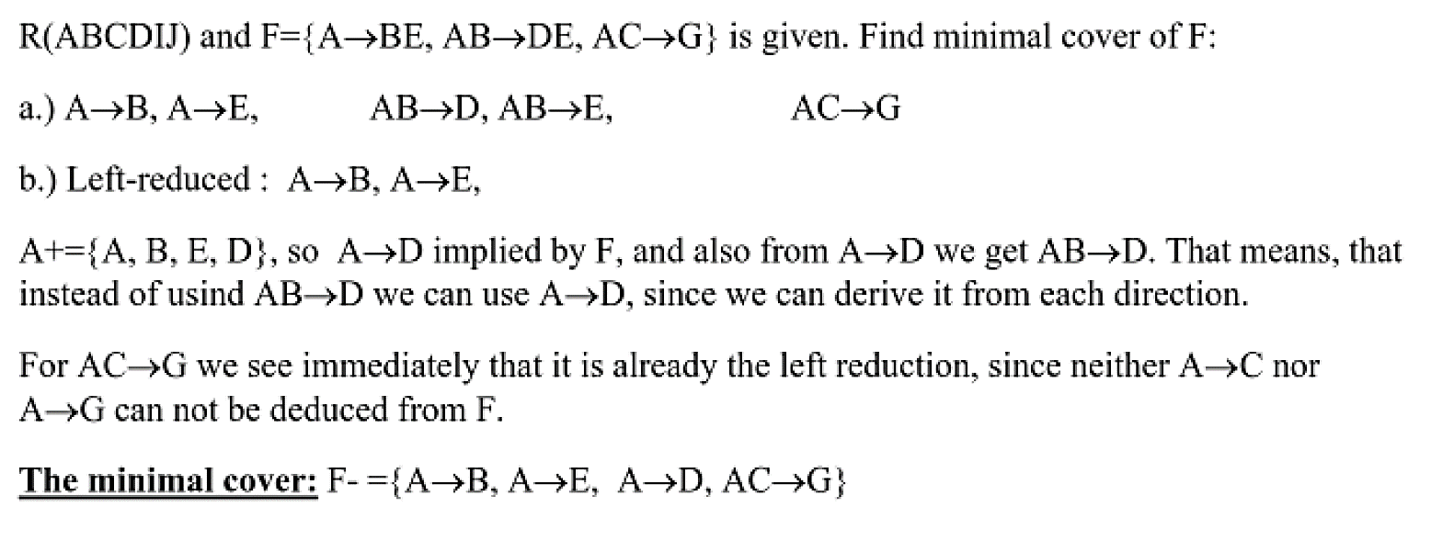
Example-5
R(A B C D E G) and F = {A → BE, AB → DE, AC → G}. Find the Minimal Cover.

Slide 53
Example-6
Given relation R(ABCDEG) and functional dependencies F = {ABD → CE, BC → D, CD → E, DE → G, A → B}. Compute a canonical cover of F.
Step 1: G = {ABD → CE, BC → D, CD → E, DE → G, A → B}.
Step 2: Remove redundant attributes from L.H.S. of fd’s.
Look at ABD → CE.
Try to remove A: BD⁺ = BD. Since CE ∉ BD⁺ , BD → CE ∉ F⁺, and thus A cannot be removed from ABD → CE.
Try to remove B: AD⁺ = ADBCEG. Here C ∈ AD⁺ and E ∈ AD⁺ , therefore AD → CE ∈ F⁺ . Thus we can indeed remove B from the L.H.S. of ABD → CE.
Try to remove D from AD → CE: A⁺ = AB. Since A⁺ does not contain either C or E, attribute D cannot be removed. No redundant L.H.S. attributes are found in other fd’s.
After step 2, G = {AD → CE, BC → D, CD → E, DE → G, A → B}.

Slide 54
Contd.
Step 3: Remove redundant R.H.S. attributes: The only redundant R.H.S. attribute is attribute E in AD → CE: this is because AD → E can be derived from AD → C (and thus AD → CD) and CD → E.
So we get G = { AD → C, BC → D, CD → E, DE → G, A → B}.
Step 4: In the repeat until loop: No more changes to G can be made, thus
G = {AD → C, BC → D, CD → E, DE → G, A → B}.

Slide 55


